Slide 1


고객가치
새로운 시도
집요한 실행
Lens Calibration

Slide 2




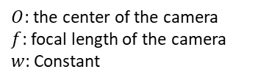

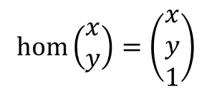







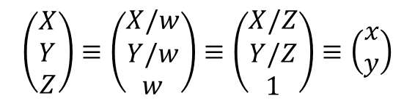
Lens Calibration: Homogeneous coordinate
$$\left(\frac{X}{w},\frac{Y}{w}\right)$$
$$P$$
$$\left(\frac{X}{Z},\frac{Y}{Z}\right)$$
$$\left(X,Y,Z\right)$$
Red dots are colinear.
All points on the line $OP$ projected to $\left(x,y\right)$
$$o$$
$$z$$
$$1$$
$$w$$
camera center
In projective geometry, any colinear points are projected to the same point on the plane at $z=1$.
$$x$$
$$\left(\begin{matrix}X \\ Y \\ Z\end{matrix}\right)≡\left(\begin{matrix}X/w \\ Y/w \\ w\end{matrix}\right)≡\left(\begin{matrix}X/Z \\ Y/Z \\ 1\end{matrix}\right)≡\left(\begin{matrix}x \\ y\end{matrix}\right)$$
$$y$$
$O$: the center of the camera
$f$: focal length of the camera
$w$: Constant
The homogeneous coordinate of a 2D point is then,
$$\operatorname{hom}\left(\begin{matrix}x \\ y\end{matrix}\right)=\left(\begin{matrix}x \\ y \\ 1\end{matrix}\right)$$

Slide 3
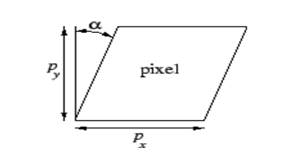


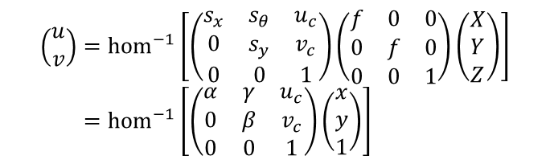



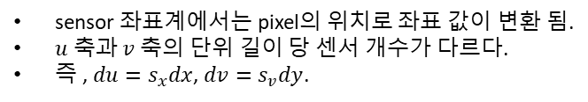











Lens Calibration: four coordinates
There are 4 coordinates in the pinhole camera model.
World coordinates.
Image coordinates.
Normalized image coordinates.
Sensor coordinates.
Sensor(pixel) coordinates
$s_{u}$ pixels per unit length
$$u$$
$$\left(0,0\right)≡\left(u_{c},v_{c}\right)$$
$$x$$
a projected point
$s_{v}$ pixels per unit length
$$\left(\frac{fX}{Z},\frac{fY}{Z},f\right)$$
$$P$$
$$\left(x,y,1\right)≡\left(x,y\right)$$
$$\left(X,Y,Z\right)$$
$$y$$
$$\left(x,y\right)≡\left(u,v\right)$$
$$v$$
sensor 좌표계에서는 pixel의 위치로 좌표 값이 변환 됨.
$u$ 축과 $v$ 축의 단위 길이 당 센서 개수가 다르다.
즉 , $du=s_{x}dx$, $dv=s_{v}dy$.
$$o$$
$$1$$
$$f$$
camera center
$$\left(\begin{matrix}u \\ v\end{matrix}\right)={hom}^{−1}\left[\left(\begin{matrix}s_{x} & s_{θ} & u_{c} \\ 0 & s_{y} & v_{c} \\ 0 & 0 & 1\end{matrix}\right)\left(\begin{matrix}f & 0 & 0 \\ 0 & f & 0 \\ 0 & 0 & 1\end{matrix}\right)\left(\begin{matrix}X \\ Y \\ Z\end{matrix}\right)\right] \\ ={hom}^{−1}\left[\left(\begin{matrix}α & γ & u_{c} \\ 0 & β & v_{c} \\ 0 & 0 & 1\end{matrix}\right)\left(\begin{matrix}x \\ y \\ 1\end{matrix}\right)\right]$$
$$y$$
$$x$$
normalized
image plane
image plane
$O$: the center of the camera
$f$: focal length of the camera
Intrinsic parameters
Skew coefficient.

Slide 4
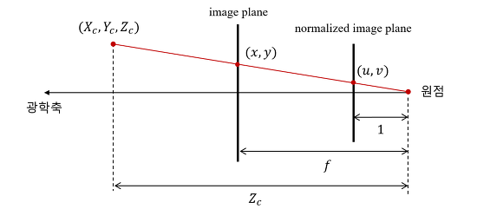
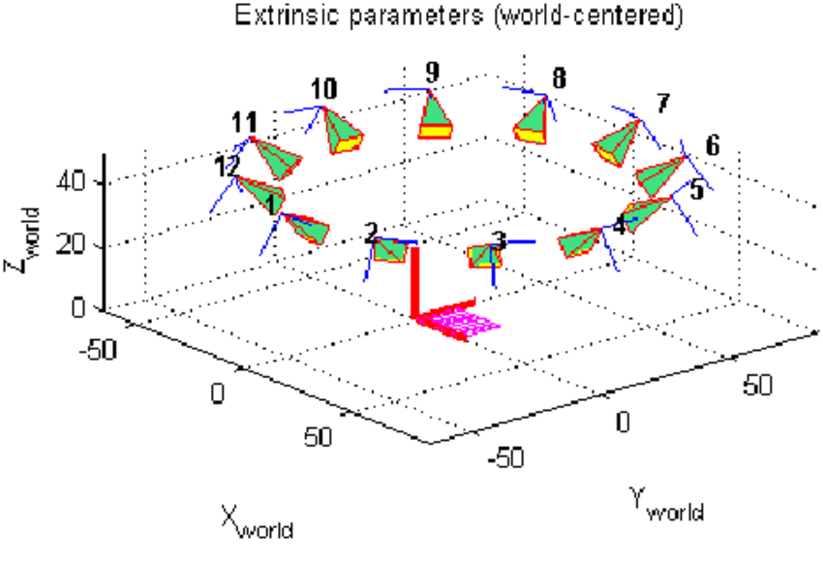

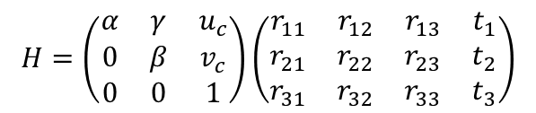
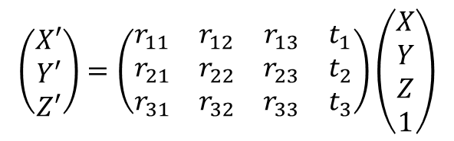


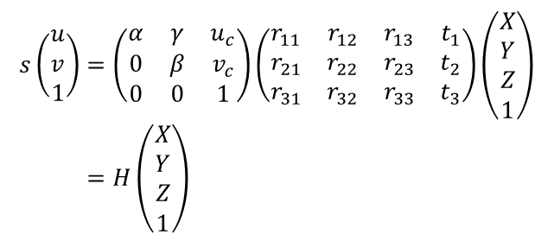

Lens Calibration: Homography matrix
Camera matrix (Projection matrix)
optical axis
$$s\left(\begin{aligned}u \\ v \\ 1\end{aligned}\right)=\left(\begin{matrix}α & γ & u_{c} \\ 0 & β & v_{c} \\ 0 & 0 & 1\end{matrix}\right)\left(\begin{matrix}r_{11} & r_{12} & r_{13} & t_{1} \\ r_{21} & r_{22} & r_{23} & t_{2} \\ r_{31} & r_{32} & r_{33} & t_{3}\end{matrix}\right)\left(\begin{aligned}X \\ Y \\ Z \\ 1\end{aligned}\right) \\ =H\left(\begin{aligned}X \\ Y \\ Z \\ 1\end{aligned}\right)$$
Rigid body transformations: orientation and translation
$$X^{′}=R⋅X+t$$
$f$: The focal length in pixel unit.
$γ$: skew coefficient. Usually, 0 for modern camera
$u_{c},v_{c}$: the coordinate of the principal point in pixel unit.
$$R=\left(\begin{matrix}r_{11} & r_{12} & r_{13} \\ r_{21} & r_{22} & r_{23} \\ r_{31} & r_{32} & r_{33}\end{matrix}\right)$$
$$t=\left(\begin{matrix}t_{1} \\ t_{2} \\ t_{3}\end{matrix}\right)$$
$$H=\left(\begin{matrix}α & γ & u_{c} \\ 0 & β & v_{c} \\ 0 & 0 & 1\end{matrix}\right)\left(\begin{matrix}r_{11} & r_{12} & r_{13} & t_{1} \\ r_{21} & r_{22} & r_{23} & t_{2} \\ r_{31} & r_{32} & r_{33} & t_{3}\end{matrix}\right)$$
$$\left(\begin{matrix}X′ \\ Y′ \\ Z′\end{matrix}\right)=\left(\begin{matrix}r_{11} & r_{12} & r_{13} & t_{1} \\ r_{21} & r_{22} & r_{23} & t_{2} \\ r_{31} & r_{32} & r_{33} & t_{3}\end{matrix}\right)\left(\begin{aligned}X \\ Y \\ Z \\ 1\end{aligned}\right)$$
intrinsic parameters
extrinsic parameters

Slide 5
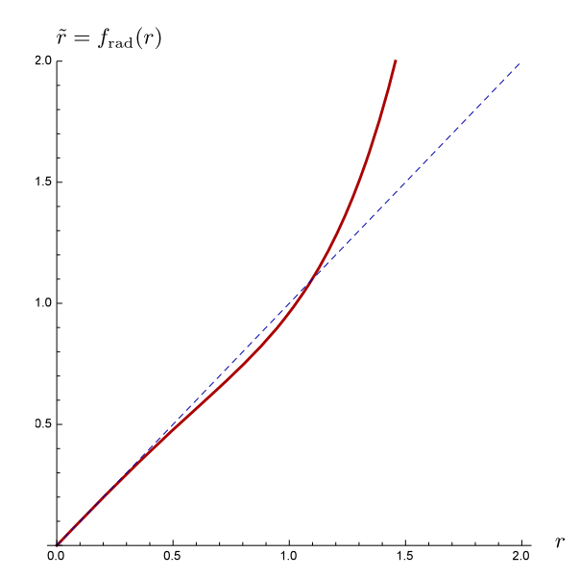
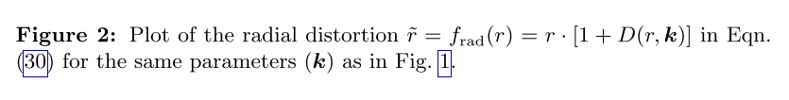








Lens Cal
$$\left(X,Y,Z\right)$$
$$P$$
$$o$$
$$1$$
camera center
an observed point
normalized
image plane
$$y$$
$O$: the center of the camera
$f$: focal length of the camera
Lens distortion affects the location of the point before the image-to-sensor transformation.
Usually, we consider only the radial distortion
$$\tilde{r}=f_{rad}\left(r\right)=r⋅\left[1+D\left(r,k\right)\right]$$
$$D\left(r,k\right)=k_{0}⋅r^{2}+k_{1}⋅r^{4}$$
$r$: radial distance from the center to the projected point.
$\tilde{r}$: radial distance from the center to the observed point.
The complete projection process is:
World-to-camera transformation.
Projection onto the normalized image plane.
Radial lens distortion
Affine 2D transformation to sensor coordinates.

Slide 6

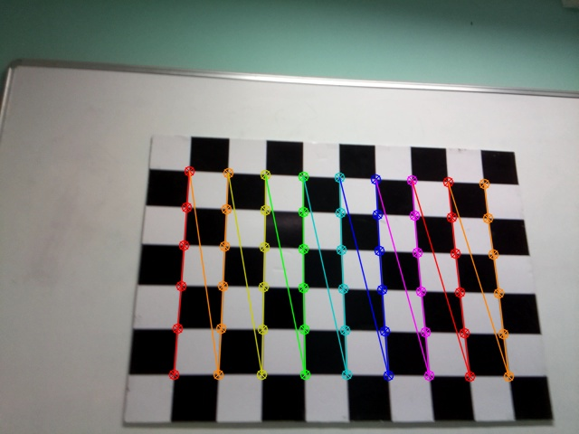













Lens Cal
Summarized Lens Calibration process
OpenCV 사용
Print a pattern and attach it to a planar surface.
Take several images with different locations and orientations by moving either the plane or camera.
Detect the corners of the chessboard.
Estimate intrinsic and extrinsic parameters.
Refine the found parameters.
Obtain the distortion parameters and undistort the image.
Repeat 4~6 until all the parameters converge.
$←$ Corner detector algorithm.
Harry’s operator
Forstner’s algorithm
Suzuki’s algorithm
Alexander’s algorithm
etc.
$←$ Zhang’s technique.
$←$ The Levenberg-Marquardt algorithm.
$←$ The Brown-Conrady model.
World coordinate
Sensor coordinate
$$x$$
53rd : $\left(5,8\right)$
640 pixels
$6×9$ corners
53rd : $\left(x_{53}^{′},y_{53}^{′}\right)$
5th : $\left(5,0\right)$
480 pixels
$$y$$
2nd
1st : $\left(1,0\right)$
1st
0th : $\left(0,0\right)$
6th
6th
0th : $\left(u_{0}^{′},v_{0}^{′}\right)$

Slide 7
Lens Cal
Summarized Lens Calibration process
Print a pattern and attach it to a planar surface.
Take several images with different locations and orientations by moving either the plane or camera.
Detect the corners of the chessboard.
Estimate intrinsic and extrinsic parameters.
Refine the found parameters.
Obtain the distortion parameters and undistort the image.
Repeat 4~6 until all the parameters converge.
$←$ Corner detector algorithm.
Harry’s operator
Forstner’s algorithm
Suzuki’s algorithm
Alexander’s algorithm
etc.
$←$ Zhang’s technique.
$←$ The Levenberg-Marquardt algorithm.
$←$ The Brown-Conrady model.
Burger의 논문 참조함.
Function Tree
Calibrate Camera
estimate homography
Get normalized matrix
Get homographies
Refine homography
Get residuals
Get value
검증 완료
Get camera intrinsics
SVD
Get Jacobian
Get camera extrinsics
estimate view transform
make true rotation matrix
Estimate distortion
image to normal
검증 필요
normal to sensor
Refine all parameters
Get residuals
Get value
To rotation
Get Jacobian
To Rodrigues
직접 개발
Decompose P vector
기존 library 일부 사용
Compose P vector
기존 library 사용

Slide 8
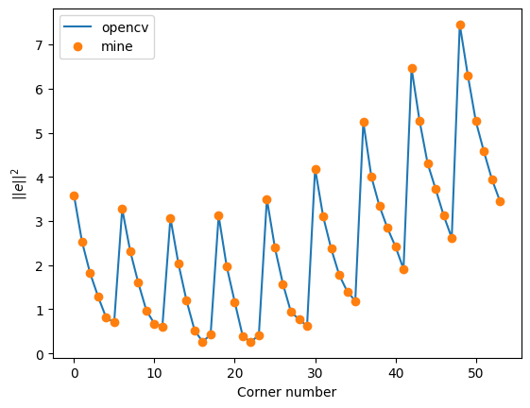
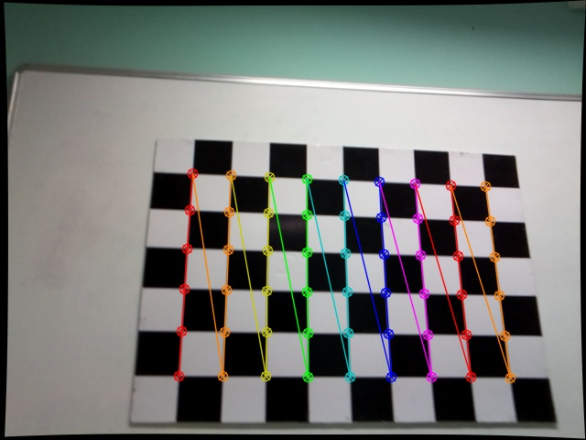


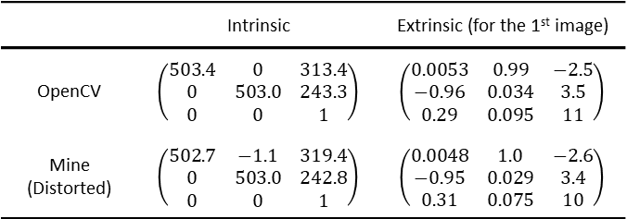


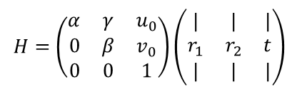
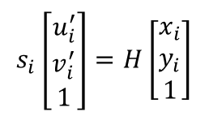
Lens Cal
Homography matrix
$$s_{i}\left[\begin{matrix}u_{i}^{′} \\ v_{i}^{′} \\ 1\end{matrix}\right]=H\left[\begin{matrix}x_{i} \\ y_{i} \\ 1\end{matrix}\right]$$
$H=$ $\left(\begin{matrix}α & γ & u_{0} \\ 0 & β & v_{0} \\ 0 & 0 & 1\end{matrix}\right)\left(\begin{matrix}| & | & | \\ r_{1} & r_{2} & t \\ | & | & |\end{matrix}\right)$
intrinsic parameters
extrinsic parameters
 | $H$ (1st image)
OpenCV | $$\left(\begin{matrix}9.60 & 50.2 & 193 \\ −39.1 & 3.35 & 412 \\ 0.0297 & 0.00703 & 1.00\end{matrix}\right)$$
Mine | $$\left(\begin{matrix}9.60 & 50.2 & 193 \\ −39.1 & 3.35 & 412 \\ 0.0297 & 0.00703 & 1.00\end{matrix}\right)$$
 | Intrinsic | Extrinsic (for the 1st image)
OpenCV | $$\left(\begin{matrix}503.4 & 0 & 313.4 \\ 0 & 503.0 & 243.3 \\ 0 & 0 & 1\end{matrix}\right)$$ | $$\left(\begin{matrix}0.0053 & 0.99 & −2.5 \\ −0.96 & 0.034 & 3.5 \\ 0.29 & 0.095 & 11\end{matrix}\right)$$
Mine (Distorted) | $$\left(\begin{matrix}502.7 & −1.1 & 319.4 \\ 0 & 503.0 & 242.8 \\ 0 & 0 & 1\end{matrix}\right)$$ | $$\left(\begin{matrix}0.0048 & 1.0 & −2.6 \\ −0.95 & 0.029 & 3.4 \\ 0.31 & 0.075 & 10\end{matrix}\right)$$
Distorted image
48
A corner in the undistorted image found by suing OpenCV
A corner in the distorted image
5
54
4
$$\left(u_{0}^{′}, v_{0}^{′}\right)$$
3
2
1
0
6
48
0
12
6
12
$$\left(u_{0}, v_{0}\right)$$
Undistorted image (OpenCV)
1
2
54
$$e=\left(u_{0}^{′}−u_{0}, v_{0}^{′}−v_{0}\right)$$

Slide 9
5. Lens Cal
LSI XY Cal Algorithm reverse engineering 계획
삼성 LSI의 iToF Camera Cal C++ code 확보 (from 박상형 책임).
삼성 LSI는 Infineon의 iToF Camera Cal 코드를 일부 modify하여 사용.
Infineon의 XY Cal은 3개의 chart를 두고 한 장의 사진만 획득하여 XY Cal 진행.
S/W개발팀의 김승윤 선임과 알고리즘 구현 경험을 바탕으로 코드를 분석하여 Customized XY Cal library 구축 예정.
Function Tree
LENS_ CalibrationMain
LENS_CalculatePattern
LENS_DetectPattern
LENS_subfunction_Blob_floodFill_Equal_Matlab
Defined but not called.
LENS_subfunction_Blob_floodfill
LENS_PatternMatching2Mask
LENS_subfunction_Find_Min_Value_Idx
LENS_subfunction_CreateTemplate
LENS_subfunction_Find_CxCy_rulebase
LENS_subfunction_FindMaxIdx
LENS_FitLensParams
LENS_subfunction_Calc_Error_Polynomial
LENS_subfunction_Calc_Reprojection_Error
ReadJson_LensCalSet
LENS_subfunction_Find_Min_Value_Idx
LENS_Convert
LENS_MakeGT
LENS_Calc_Undistortion_Points
LENS_SetParameter

Slide 10
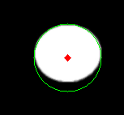
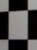
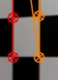
Lens Cal
XY Cal Chart type comparison
구분 |  | LED chart type | Checkerboard chart type
Version |  | 단일 | Back light/Front light/Tx light * Chart의 light source가 없음
장단점 비교 | Geo cal. 정확도 | 왜곡 보정 효과가 낮음 * Chart 제작 공정상 조립오차 발생 | 왜곡 보정 효과가 높음 * Chart design을 인쇄하는 방식
 | 부피 | 소형화 가능 | 큰 공간 필요 * Chart + IR light source
 | 차트 수정 | 불가능함 | Chart design 수정 후 인쇄하므로 용이함
 | Rx 해상도 | 저해상도 Rx에서도 detection 우수함 | 저해상도 Rx 경우 corner detection의 어려움 존재
Schematics
Find
center
find
center

Slide 11
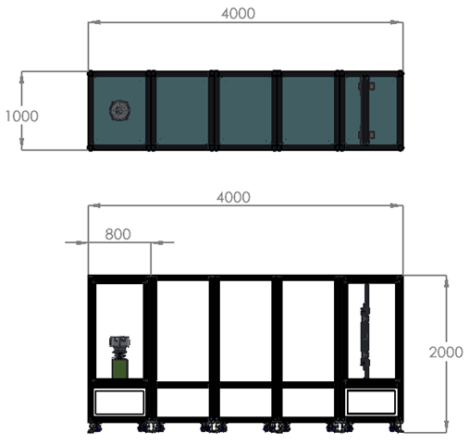




Lens Cal
XY Cal 장비 concept
현재 (M-LiDAR Cal 셋팅)
향후 (S-LiDAR Cal 셋팅)
4m
LED dot 사이 간격
1m
0.7 m
$\sim 10$ cm
1 m
$\sim 10$ cm
3.1 m
2m
LiDAR Module
Pixel 간의 간섭 없이 LED dot을 인식하기에 적당.
$120°의$ 광각을 보기에는 부족
2.0 m
~80cm
~ 4.0 m
~140cm
$$60°$$
1.6 m

Slide 12
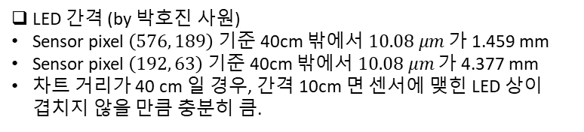




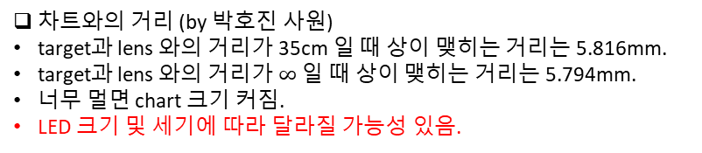




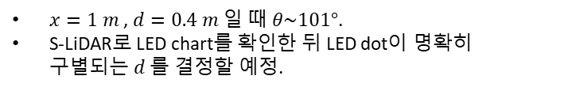

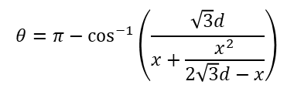






Lens Cal
XY Cal 장비 concept
$$l$$
$$x/2$$
Depth of focus
$$x$$
Depth of field
$$θ$$
$$x\sin{θ}$$
$$π−θ$$
$$\sqrt{3}d$$
$$d$$
$$60°$$
$$d+x\sin{θ}$$
$$2d$$
$5.794$ mm
$5.816$ mm
S-LiDAR
$$x/2:\sqrt{3}d=l:l+x$$
$$l=\frac{x^{2}}{2\sqrt{3}d−x}$$
차트와의 거리 (by 박호진 사원)
target과 lens 와의 거리가 35cm 일 때 상이 맺히는 거리는 5.816mm.
target과 lens 와의 거리가 $∞$ 일 때 상이 맺히는 거리는 5.794mm.
너무 멀면 chart 크기 커짐.
LED 크기 및 세기에 따라 달라질 가능성 있음.
$$θ=π−\cos^{−1}\left(\frac{\sqrt{3}d}{x+\frac{x^{2}}{2\sqrt{3}d−x}}\right)$$
LED 간격 (by 박호진 사원)
Sensor pixel $\left(576, 189\right)$ 기준 40cm 밖에서 $10.08 μm$ 가 1.459 mm
Sensor pixel $\left(192, 63\right)$ 기준 40cm 밖에서 $10.08 μm$ 가 4.377 mm
차트 거리가 40 cm 일 경우, 간격 10cm 면 센서에 맺힌 LED 상이 겹치지 않을 만큼 충분히 큼.
$x=1 m$ , $d=0.4 m$ 일 때 $θ\sim 101°$.
S-LiDAR로 LED chart를 확인한 뒤 LED dot이 명확히 구별되는 $d$ 를 결정할 예정.

Slide 13






Lens Calibration: Lens distortion
$O$: the center of the camera
$f$: focal length of the camera
a projected point
$$P$$
$$\left(X,Y,Z\right)$$
$$o$$
$$1$$
$$f$$
camera center
an observed point
$$y$$
$$x$$
normalized
image plane
image plane
Lens distortion affects the location of the point before the image-to-sensor transformation.

Slide 14









XY Cal Algorithm 구현 현황
Summarized Lens Calibration process
Print a pattern and attach it to a planar surface.
Take several images with different locations and orientations by moving either the plane or camera.
Detect the corners of the chessboard.
Estimate intrinsic and extrinsic parameters.
Refine the found parameters.
Obtain the distortion parameters and undistort the image.
Repeat 4~6 until all the parameters converge.
$←$ Corner detector algorithm.
Harry’s operator
Forstner’s algorithm
Suzuki’s algorithm
Alexander’s algorithm
etc.
$←$ Zhang’s technique.
$←$ The Levenberg-Marquardt algorithm.
$←$ The Brown-Conrady model.
World coordinate
Sensor coordinate
$$x$$
53rd : $\left(5,8\right)$
640 pixels
$6×9$ corners
53rd : $\left(x_{53}^{′},y_{53}^{′}\right)$
5th : $\left(5,0\right)$
480 pixels
$$y$$
2nd
1st : $\left(1,0\right)$
1st
0th : $\left(0,0\right)$
6th
6th
0th : $\left(u_{0}^{′},v_{0}^{′}\right)$

Slide 15
XY Cal Algorithm 구현 현황
Summarized Lens Calibration process
Print a pattern and attach it to a planar surface.
Take several images with different locations and orientations by moving either the plane or camera.
Detect the corners of the chessboard.
Estimate intrinsic and extrinsic parameters.
Refine the found parameters.
Obtain the distortion parameters and undistort the image.
Repeat 4~6 until all the parameters converge.
$←$ Corner detector algorithm.
Harry’s operator
Forstner’s algorithm
Suzuki’s algorithm
Alexander’s algorithm
etc.
$←$ Zhang’s technique.
$←$ The Levenberg-Marquardt algorithm.
$←$ The Brown-Conrady model.
Burger의 논문 참조함.
Function Tree
Calibrate Camera
estimate homography
Get normalized matrix
Get homographies
Refine homography
Get residuals
Get value
검증 완료
Get camera intrinsics
SVD
Get Jacobian
Get camera extrinsics
estimate view transform
make true rotation matrix
Estimate distortion
image to normal
검증 필요
normal to sensor
Refine all parameters
Get residuals
Get value
To rotation
Get Jacobian
To Rodrigues
직접 개발
Decompose P vector
기존 library 일부 사용
Compose P vector
기존 library 사용

Slide 16
XY Cal Algorithm 구현 현황
Homography matrix
$$s_{i}\left[\begin{matrix}u_{i}^{′} \\ v_{i}^{′} \\ 1\end{matrix}\right]=H\left[\begin{matrix}x_{i} \\ y_{i} \\ 1\end{matrix}\right]$$
$H=$ $\left(\begin{matrix}α & γ & u_{0} \\ 0 & β & v_{0} \\ 0 & 0 & 1\end{matrix}\right)\left(\begin{matrix}| & | & | \\ r_{1} & r_{2} & t \\ | & | & |\end{matrix}\right)$
intrinsic parameters
extrinsic parameters
 | $H$ (1st image)
OpenCV | $$\left(\begin{matrix}9.60 & 50.2 & 193 \\ −39.1 & 3.35 & 412 \\ 0.0297 & 0.00703 & 1.00\end{matrix}\right)$$
Mine | $$\left(\begin{matrix}9.60 & 50.2 & 193 \\ −39.1 & 3.35 & 412 \\ 0.0297 & 0.00703 & 1.00\end{matrix}\right)$$
 | Intrinsic | Extrinsic (for the 1st image)
OpenCV | $$\left(\begin{matrix}503.4 & 0 & 313.4 \\ 0 & 503.0 & 243.3 \\ 0 & 0 & 1\end{matrix}\right)$$ | $$\left(\begin{matrix}0.0053 & 0.99 & −2.5 \\ −0.96 & 0.034 & 3.5 \\ 0.29 & 0.095 & 11\end{matrix}\right)$$
Mine (Distorted) | $$\left(\begin{matrix}502.7 & −1.1 & 319.4 \\ 0 & 503.0 & 242.8 \\ 0 & 0 & 1\end{matrix}\right)$$ | $$\left(\begin{matrix}0.0048 & 1.0 & −2.6 \\ −0.95 & 0.029 & 3.4 \\ 0.31 & 0.075 & 10\end{matrix}\right)$$
Distorted image
48
A corner in the undistorted image found by suing OpenCV
A corner in the distorted image
5
54
4
$$\left(u_{0}^{′}, v_{0}^{′}\right)$$
3
2
1
0
6
48
0
12
6
12
$$\left(u_{0}, v_{0}\right)$$
Undistorted image (OpenCV)
1
2
54
$$e=\left(u_{0}^{′}−u_{0}, v_{0}^{′}−v_{0}\right)$$

Slide 17
XY Cal Chart type comparison
구분 |  | LED chart type | Checkerboard chart type
Version |  | 단일 | Back light/Front light/Tx light * Chart의 light source가 없음
장단점 비교 | Geo cal. 정확도 | 왜곡 보정 효과가 낮음 * Chart 제작 공정상 조립오차 발생 | 왜곡 보정 효과가 높음 * Chart design을 인쇄하는 방식
 | 부피 | 소형화 가능 | 큰 공간 필요 * Chart + IR light source
 | 차트 수정 | 불가능함 | Chart design 수정 후 인쇄하므로 용이함
 | Rx 해상도 | 저해상도 Rx에서도 detection 우수함 | 저해상도 Rx 경우 corner detection의 어려움 존재
Schematics
Find
center
find
center

Slide 18




XY Cal 장비 concept
현재 (M-LiDAR Cal 셋팅)
향후 (S-LiDAR Cal 셋팅)
4m
LED dot 사이 간격
1m
0.7 m
$\sim 10$ cm
1 m
$\sim 10$ cm
3.1 m
2m
LiDAR Module
Pixel 간의 간섭 없이 LED dot을 인식하기에 적당.
$120°의$ 광각을 보기에는 부족
2.0 m
~ 4.0 m
~80cm
~140cm
$$60°$$
1.6 m

Slide 19






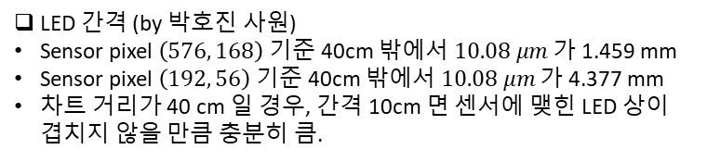









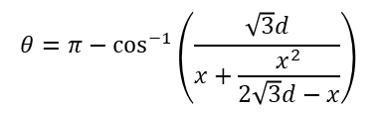
XY Cal 장비 concept
$$l$$
$$x/2$$
Depth of focus
$$θ$$
$$x$$
Depth of field
$$x\sin{θ}$$
$$π−θ$$
$$\sqrt{3}d$$
$$d$$
$$60°$$
$$d+x\sin{θ}$$
$$2d$$
$5.794$ mm
$5.816$ mm
S-LiDAR
$$l=\frac{x^{2}}{2\sqrt{3}d−x}$$
$$x/2:\sqrt{3}d=l:l+x$$
차트와의 거리 (by 박호진 사원)
target과 lens 와의 거리가 35cm 일 때 상이 맺히는 거리는 5.816mm.
target과 lens 와의 거리가 $∞$ 일 때 상이 맺히는 거리는 5.794mm.
너무 멀면 chart 크기 커짐.
LED 크기 및 세기에 따라 달라질 가능성 있음.
$$θ=π−\cos^{−1}\left(\frac{\sqrt{3}d}{x+\frac{x^{2}}{2\sqrt{3}d−x}}\right)$$
LED 간격 (by 박호진 사원)
Sensor pixel $\left(576, 168\right)$ 기준 40cm 밖에서 $10.08 μm$ 가 1.459 mm
Sensor pixel $\left(192, 56\right)$ 기준 40cm 밖에서 $10.08 μm$ 가 4.377 mm
차트 거리가 40 cm 일 경우, 간격 10cm 면 센서에 맺힌 LED 상이 겹치지 않을 만큼 충분히 큼.
$x=1 m$ , $d=0.4 m$ 일 때 $θ\sim 101°$.
S-LiDAR로 LED chart를 확인한 뒤 LED dot이 명확히 구별되는 $d$ 를 결정할 예정.

Slide 20
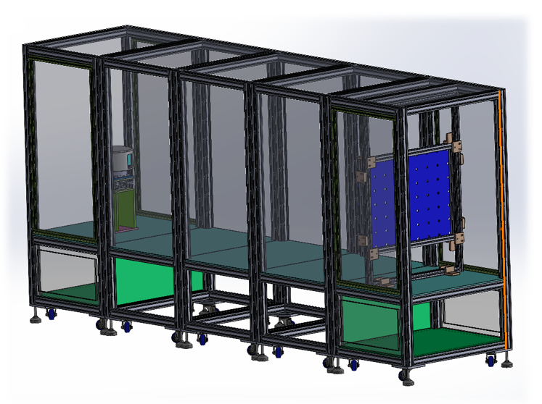


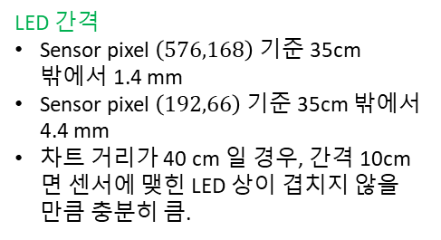

XY Cal 장비 concept
Concept by 박상형 책임
양 옆 chart는 추가 됨.
LED dot 사이 간격
$\sim$20 cm
$\sim$20 cm
Geo. Cal. Target
≈120°
LiDAR
LED 간격
Sensor pixel $\left(576,168\right)$ 기준 35cm 밖에서 1.4 mm
Sensor pixel $\left(192,66\right)$ 기준 35cm 밖에서 4.4 mm
차트 거리가 40 cm 일 경우, 간격 10cm 면 센서에 맺힌 LED 상이 겹치지 않을 만큼 충분히 큼.
LED Chart
~ 140cm
~ 40cm
$$60°$$
외부광원
(적외선)
차트와의 거리
심도 고려하면 이론적으로 32cm 이상 (by 박호진 사원).
margin 두고 40 cm.
너무 멀면 chart 크기 커짐.
LED 크기 및 세기, 화질에 따라 달라질 가능성 있음.
RX
TX

Slide 21
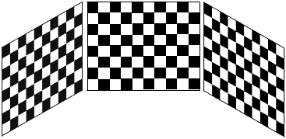
Lens Calibration
 | 기존 업체

Slide 22
Lens Calibration
Detecting algorithm comparison
 | Chess board | LED chart
function name | cv2.findChessboardCornersSB() | cv2.HoughCircles()
Schematics
Pros | 왜곡 보정 효과가 높음 | 왜곡 보정 효과가 낮음.
Cons | 화소가 많아야 모서리를 정확히 특정할 수 있음. | 상대적으로 화소가 적어도 원을 특정할 수 있음.
find
corners
find
center

Slide 23
Lens Calibration
 | Chess board (Front light) | Chess board (Back light) | LED chart
Schematic
Pros
Cons
Geo. Cal. Target
≈120°
LiDAR

